Slide 1




Open Science and IPR
Network-Wide Training of ESCs and ECPs for Capacity Building
7 November 2019, Hotel Rila, Borovets, Bulgaria
Nikola Korunović, Dragan Mišić,
Nikola Vitković & Miroslav Trajanović
University of Niš, Faculty of Mechanical Engineering

Slide 2

Goals
An introduction to Open Science (OS)
Deeper insight into elements of OS through real-life examples and exercises
Excerpt from one-day “Train the Trainers” course on Open Science and Intellectual Property Rights aimed at:
  Personnel of EURAXESS career development (CD) centers
  EURAXESS staff providing limited CD Services
  Researchers

Slide 3

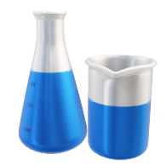
Why take a training on Open Science?
The term “Open Science” relates to the movement and the approach to science it promotes, that became extremely important in recent years
In Europe, this is recognized through a large number of projects and initiatives that support and promote the application of principles of Open Science
Moreover, it is now mandatory to apply some of these principles within H2020 projects
The principle of ‘Open Science' will become the modus operandi of Horizon Europe, requiring open access to publications and data

Slide 4

What is openness?
“Open means anyone can freely access, use, modify, and share for any purpose
(subject, at most, to requirements that preserve provenance and openness).”
(Open Definition)
This Photo by Steve Wickham is licensed under CC BY-NC-ND

Slide 5

What is open science?
G. Emmerich
/ CC-BY-SA-3.0
“The movement to make scientific research, data and dissemination accessible to all levels of an inquiring society." (FOSTER Taxonomy).
„The practice of science in such a way that others can collaborate and contribute, where research data, lab notes and other research processes are freely available, under terms that enable reuse, redistribution and reproduction of the research and its underlying data and methods.“ (FOSTER).
Open Science aims at transforming science through ICT tools, networks and media, to make research more open, global, collaborative, creative and closer to society. (EC – Open Science Policy)
“Research simply done properly”

Slide 6
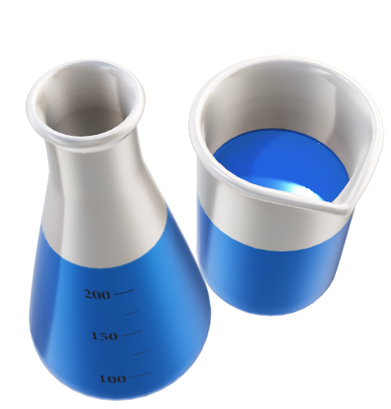

What do you think are Pros / Cons of Open Science?
Composition of participants: CDC, ESC, researchers?
Split into groups (4 – 5 persons)
Choose one Pro and one Con answer for each group (5 min.)
Please, tell us (5 min.)
?

Slide 7

Open Science and researchers
You are working with researchers or you are a researcher yourself
Let’s see Open Science from the point of view of the researchers!
This Photo by Unknown Author is licensed under CC BY-SA

Slide 8

Good Research Practice
(according to Medical Research Council)
Good researchers
Strive for excellence and take responsibility
Respect the law, research ethics, and professional standards
Support a culture of transparency, openness, and honesty towards other researchers and the public
Maximize public benefit and avoid resource waste
Continue learning and mentor others
Open Science
OSC - LMU Open science center / CC BY 4.0
Medical Research Council (2012)
Picture from freepik.com by @macrovector
Notes:
Open Science is directly connected to these points. What we are going to learn in this workshop is a set of different practices that can routinely support scientists in fulfilling these goals. This set of practices is summarized under the label of “Open Science”.

Slide 9
Why transparency?
OSC - LMU Open science center / CC BY 4.0
Wagenmakers et al. (2012)
The Confirmatory Research Process
Formulate hypotheses &
analysis plan
Replicate results
Publish & distribute research output
Collect data
Interpret & report
results
Analyze data according
to analysis plan
Notes:
So, why should we be transparent at all? Let’s take a look at the typical confirmatory research process (FYI: confirmatory = starting out with hypotheses for which you want to find evidence; exploratory = analyzing data in every possible way to find potentially meaningful structures):
You start with some hypothesis which you want to test. Then you derive a suitable plan for an experiment or some other kind of study and come up with an analysis plan (how should your results look so that they speak for or against your hypothesis?). Then you start collecting data – this can be anything from conducting chemical experiments to lab studies with humans or animals to observing things in nature or reading books. Then you analyze your collected data according to your pre-defined analysis plan and you interpret and report the results, for example “the results xyz are in favor of the hypothesis”. In the end, you publish an distribute your research output, for example in a scientific paper which makes your results accessible to a broad audience. In the end, (maybe even before you publish the paper, there are different views on this in different disciplines) you set up a replication study which can reproduce your results. Why should you do that? Because it makes your results more believable if you (or someone else) comes to the same result as you. As soon as one hypothesis could be established, you start with another research cycle.
Ask participants: Is it the same in your discipline? Would you agree with this view on science?

Slide 10
Why transparency?
OSC LMU - Open science center / CC BY 4.0
How can you know that it does not look like this?
invent some shiny new hypotheses
Formulate hypotheses &
analysis plan
Replicate results
Publish & distribute research output
but only with those who pay
Collect data
or fake it
* p < .05; that fit a theory; that are surprising / publishable…
Interpret & report
results
interesting*
Analyze data according
to analysis plan
p-hack
Notes:
We discussed what a good research process should look like. But how do you know it doesn’t look like this?
No analysis plan was derived before data collection (maybe not even hypotheses)
Data was not actually collected but faked
Data was analyzed chaotically in every possible way to squeeze out significant results
If not enough significant / theory-conform results appear, more data is collected
Only interesting results are reported (and of course no data), where suitable can mean anything from significant to theory-conform or surprising / publishable
Then these results are published, but made accessible only to those who pay a lot of money (which is usually universities)
In the end, of course, no replications because your results may not hold up which would damage your reputation and even if they do, who cares, because then the results would not be interesting because they are not at all surprising and may not be as easily publishable. Instead you rather invent some new shiny hypothesis.
This would not be good science, right? But without transparency in science, you cannot know if the research cycle does not actually look like this.

Slide 11
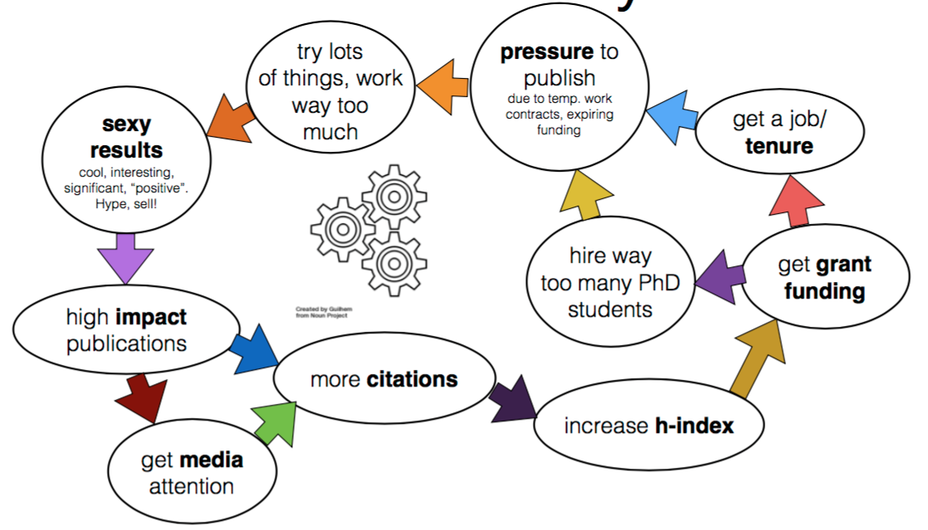
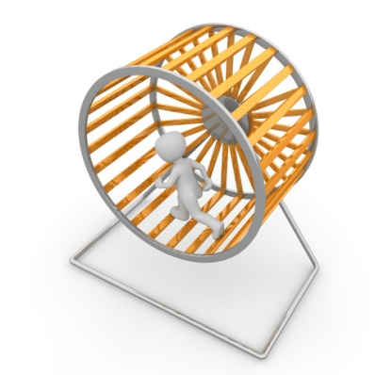
The science hamster wheel
OSC - LMU Open science center / CC BY 4.0
Arslan (2018)
Picture from pixabay.com by 3dman_eu
Notes:
I am sure that many of the attendants are already familiar with the science hamster wheel from their own experience. In many fields, there is an immense pressure to publish which is why many academics work way too much, trying to strike a rich vein with which they can produce sexy results that they can publish in high impact journals. Sexy results are thematically cool, unforeseen, positive, and, of course, significant. Through high-impact publications, researchers hope to gain the attention of the media and important people in their field so that they are cited more and have a higher h-index. Once they have many publications, they get more grants, and/or tenure, hire many PhD students, which again need to publish their results in high-impact journals to advance on the career ladder.

Slide 12
Open Science in the research process
OSC - LMU Open science center / CC BY 4.0
get all material here: https://osf.io/zjrhu/
Preregistration
Power Analysis
Replication study
Formulate hypotheses &
analysis plan
Replicate results
Registered Report (1st phase)
Open Access
Publish & distribute research output
Collect data
Open Lab Notebook
Registered Report (2nd phase)
Open Data
Interpret & report
results
Analyze data
Open Materials
Open Analysis Code

Slide 13




Why transparency?
Increase trust in science, don’t waste public resources
Get constructive
feedback
Increase the speed of discovery
Be international and inclusive
OSC - LMU Open science center / CC BY 4.0
Pictures from freepik.com by @brgfx, @makyzz; flaticon.com by Icon Pond, Dimitry Miroliubov
Notes:
So what are the main advantages of research transparency?
As we already said, you can show others that you are a good scientist. You follow the plan outlaid for confirmatory research, you don’t cheat and you don’t waste resources that were given to you by the government or the public. This is very important to build your reputation as a trustworthy researcher. However, this is not the only reason.
When you make your whole research process open, you will be more likely to get constructive feedback from colleagues. Why? First, because they can assess your whole research process, not only the output. Maybe you can even get feedback at an early stage of the research process (for example, you make your analysis plan public before data collection and someone knows a better analysis method, then he can give you that feedback before you submit a paper). Second, because they can access your work. If a paper is hidden behind a paywall (that means that people have to pay large amounts of money to the publisher to access it), not everyone might have enough money to access it – and it is not possible to give constructive feedback on something that you don’t see.
This already leads to the next point: You can foster internationality and inclusiveness in science. If you make your research process open, everyone can contribute and use it as a basis for their own research – not only members of large Western universities. This means your science will be more inclusive towards less wealthy societies and towards the public. Of course, this will be of advantage to you as well because you can act in a larger network with all its benefits.
With all this, you can increase the speed of discovery. If everyone can help together to conduct good research, if there are no access boundaries, no “secret recipes”, then there will be a fertile environment for discoveries.

Slide 14

Topics
Principles and concepts of Open Science
Citizen Science
Open Research Data and Materials
Open Access
Open Research Software and Open Source
Open Licensing, Intellectual Property Rights, Open File Formats
Collaborative Platforms
Open Peer Review, Metrics and Evaluation
Open educational resources
Open Science Policies
Open advocacy

Slide 15
Pillars of Open Science
Other important practices
Open Science
Open Data
Open Material
Open Access
Open Source (Software)
Open Peer Review
Open Educational Resources
Open Metrics
Open Licensing and File Formats
Citizen Science
Open Science Policies
Open Advocacy
Reproducibility of research
Transparency in research methods

Slide 16




What is citizen science?
Involvement of the non-academic public in the process of scientific research (citizenscience.org)
Citizens do scientific work—often working together with experts or scientific institutions
Citizen science is both an aim and enabler of Open Science
  Reading open access articles and using open research data leads to greater public understanding of science
  Citizens support the collection, analysis or description of research data

Slide 17
Key elements when starting a citizen science project
How are you going to engage citizens?
How are you going to ensure data quality?
How are you going to deal with ethics and legal issues?
Cases studies extracted from the UK Research Excellence Framework, may serve as examples of how citizen science activities can be included as societal impact in evaluation reports

Slide 18
Open Science in practice: OpenClick project
Examples in this presentation are based on OpenClick project by Faculty of Mechanical Engineering Niš
Project OpenClick aims to discover physical status, skills and abilities of people based on human – computer interaction tests
OpenClick is research project fully based on Open Science principles
Registered persons can use OpenClick project infrastructure (tools, methodology, data sets) to conduct their own research as long as they respect project’s principles, rules, IPR and licensing policy

Slide 19

Example: OpenClick and citizen science
Go to www.openclick.rs portal
Explore the portal structure
Run OpenClick: Project OpenClick > Run OpenClick,
or go directly to http://openclick.masfak.ni.ac.rs/#/
Click on Register New Account and enter your data (registration is anonymized)
Tick the box to confirm data collection and processing
Notes:
Let me draw your attention to the fact that your participation is completely anonymised. Your email is only needed if you want to run your project.
Also, notice that we do not collect or process information about you without your explicit permission.

Slide 20
Test yourself as a citizen
Sign in with your username and password
You can see the total number of participants and
the total number of tests
One participant can be tested unlimited number of times
Carefully read the instructions for each test before you perform it

Slide 21
Available tests
There are nine tests available
Each test relates to an elementary operation in interaction with a computer using mouse and keyboard
Our motto: Keep it simple
All you need to test someone's physical status are computer with mouse and keyboard
Notes:
All you need to test someone's physical status are computer with mouse and keyboard and wrist watch and ring and short thick fingers with red nails

Slide 22
Your first test
Click on mouse clicks test
Carefully read the instructions
Perform the tests
If you did not do a regular test, then quit the test (you were confused, your phone rang, any other disturbance)
Save test results
Select: Show as histogram
Compare your data with average results

Slide 23
This test is stupid and useless?
The physiotherapist told us that this is a great test that can be used for monitoring patient’s recovery after a hand injury
Neuropsychiatrist claims this is the ideal way to test whether he gave the right dose of a medicine to a patient with diagnosed schizophrenia
The sports coach wants to use this test to track sportsmans' reflexes
Each test has dozens of applications
It is possible to create a mix of tests for specific research

Slide 24
More tests
Mouse positioning speed
Selecting two keys simultaneously
Text input using the keyboard
Alternate selection of the mouse buttons

Slide 25
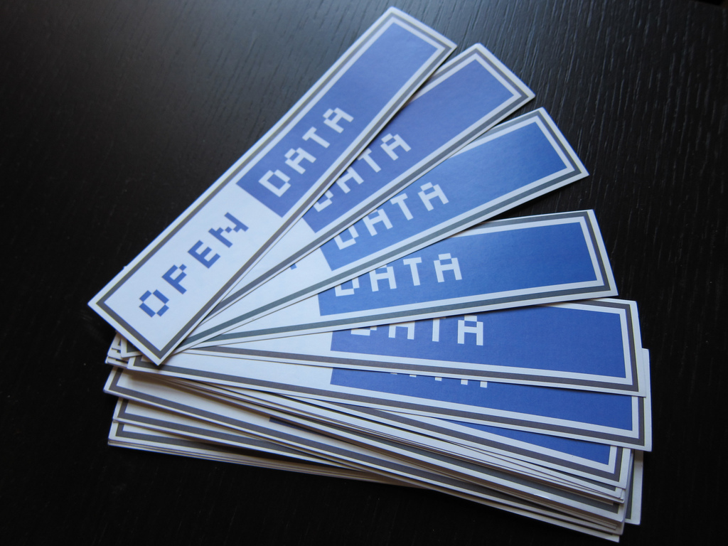
What is open research data?
Data that can be freely accessed, reused, remixed and redistributed, for purposes of academic research and teaching and beyond
Ideally, open data have no restrictions on reuse or redistribution, and are appropriately licensed as such
At most, the requirement to attribute and share alike are present

Slide 26
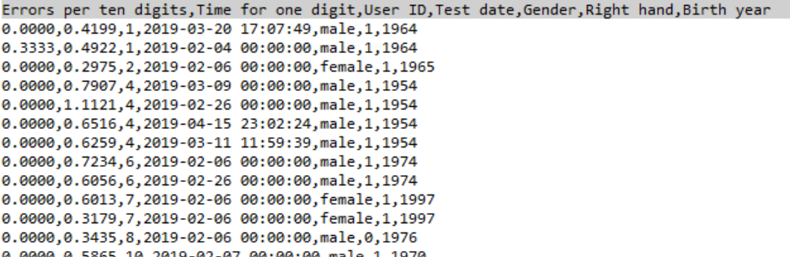
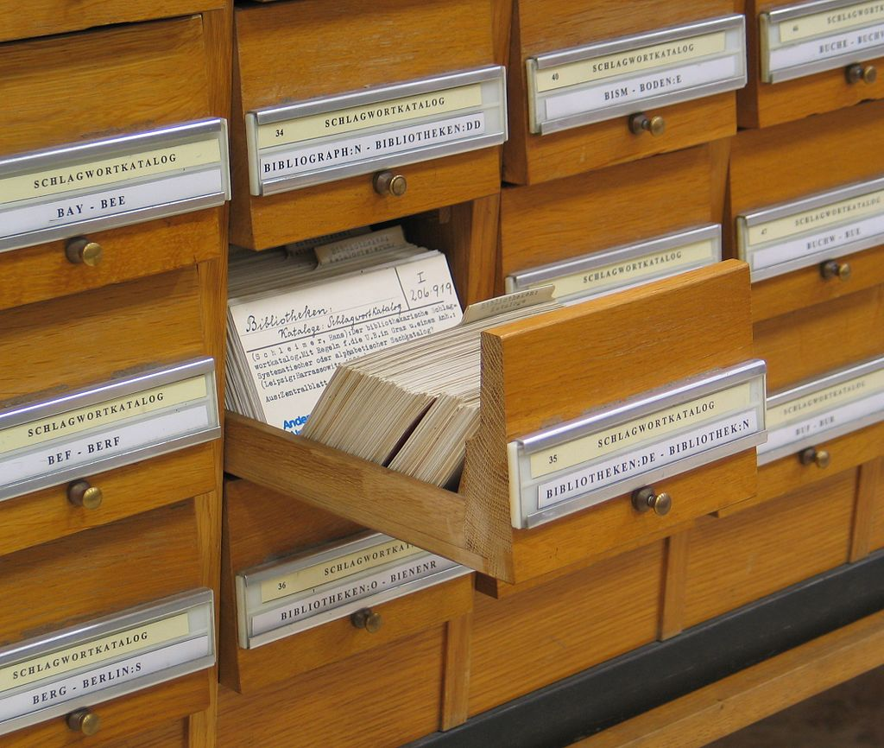
Metadata
Image by Dr. Marcus Gossler - Own work, CC BY-SA 3.0
Metadata is "data [information] that provides information about other data“ (Wikipedia).

Slide 27
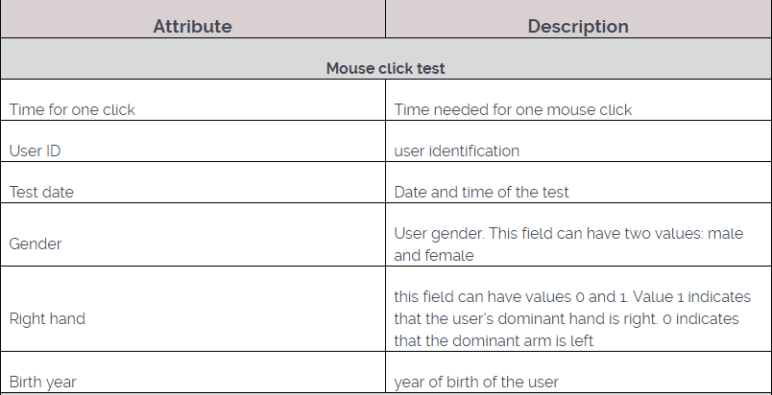
Metadata for mouse click test

Slide 28
FAIR data principles
Findable: easy to find the data and the metadata for both humans and computers. Enabled by machine-readable persistent identifiers (PIDs) and metadata
Accessible: data can be retrieved using open protocols, possibly including authentication and authorization
Interoperable: can be combined and used with other data or tools
Re-usable: well-described so that they can be replicated and/or combined in different settings

Slide 29
Difference between FAIR data and Open data
Open data should be available to everyone to access, use, and share, without licences, copyright, or patents. At most, it should be subject to attribution/share-alike licenses
FAIR data, uses the term “Accessible” to mean accessible by appropriate people, at an appropriate time, in an appropriate way. Data can be FAIR when it is private, when it is accessible by a defined group of people, or when it is accessible by everyone (open data). For example:
  New experimental data - accessible by the generator and their group to start, with consortia partners as the findings become refined, with the public upon publication
  Personally sensitive data may never be publicly accessible and usable
  Commercially sensitive data may be held privately for stretches of time after collection and interpretation. Users are also free to use more restrictive licenses to govern how the data may be reuseds
Source: Ask Open Science

Slide 30
Sharing sensitive and proprietary data
Sharing sensitive data is region-specific because of differing regulations
Within the General Data Protection Regulation (GDPR, European Union, 2016a) personal data is defined as any information relating to an identified or identifiable natural person known as ‘a data subject’
‘Special categories of personal data’ according to GDPR:
  Racial or ethnic origin; Political opinions; Religious or philosophical beliefs; Trade union membership; Genetic data; Biometric data; Data concerning health; Data concerning a natural person's sex life or sexual orientation
Notes:
RR - Researchers at Risk, Migrants

Slide 31
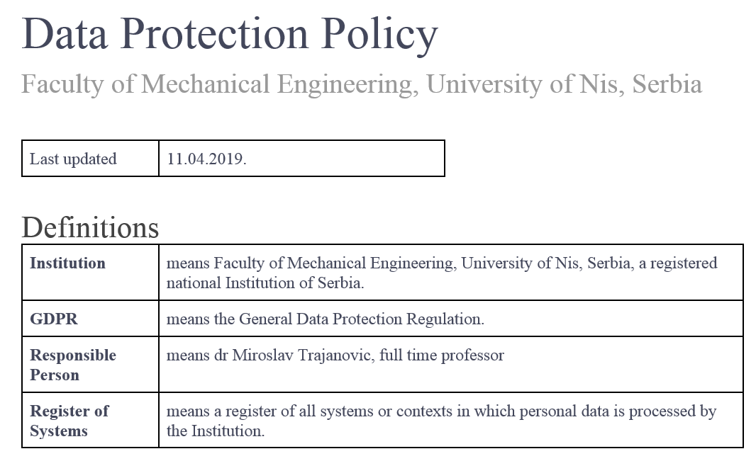
GDPR example: OpenClick Data Protection Policy
According to EU General Data Protection Regulation
Contents:
  Data protection principles
  General provisions
  Lawful, fair and transparent processing
  Lawful purposes
  Data minimization
  Accuracy
  Archiving / removal
  Security
  Breach

Slide 32
Data management plan
A Data Management Plan (DMP) is a brief plan to define:
  how the data will be created
  how it will be documented
  who will be able to access it
  where it will be stored
  who will back it up
  whether (and how) it will be shared and preserved
DMPs are often submitted as part of grant applications, but are useful whenever researchers are creating data
Further questions: CESSDA Data Management Expert Guide, part 6
DMP templates across EU: CESSDA European diversity
Source: https://www.openaire.eu/rdm-handbook

Slide 33
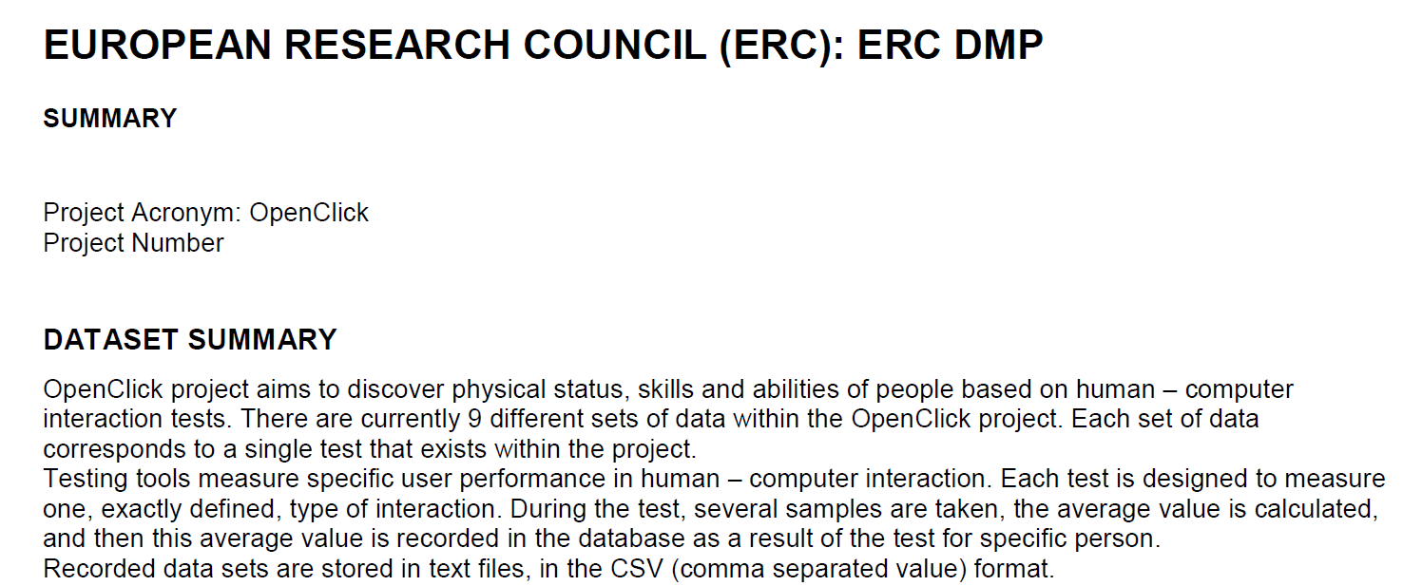
Data management plan example: OpenClick
http://www.openclick.rs/index.php/en/project-openclick/data
http://www.openclick.rs/images/files/openclickdtm.pdf

Slide 34
How to make research data accessible
As supplemental material with a research article, hosted by the publisher of the article
Hosting data on a publicly-available website, with files available for download
Depositing data in a repository developed to support data publication (e.g. Zenodo)
Publishing a data paper about the dataset (as a preprint, in a journal, or in a data journal dedicated to supporting data papers). Hosted by the journal or hosted separately in a data repository

Slide 35

Selecting a data repository
Order of preference recommended by OpenAIRE:
Use an external data archive or repository established for your research domain to preserve the data. Some recommendations are given by Nature
If available, use an institutional repository, or your research group’s established data management facilities
Use a cost-free data repository such as Dataverse, Dryad, figshare or Zenodo.
Search for other data repositories in re3data. Filter options that will help you find FAIR-compatible repositories: access categories, data usage licenses, trustworthy data repositories and data a persistent identifier (PID). Consider whether the repository supports versioning

Slide 36
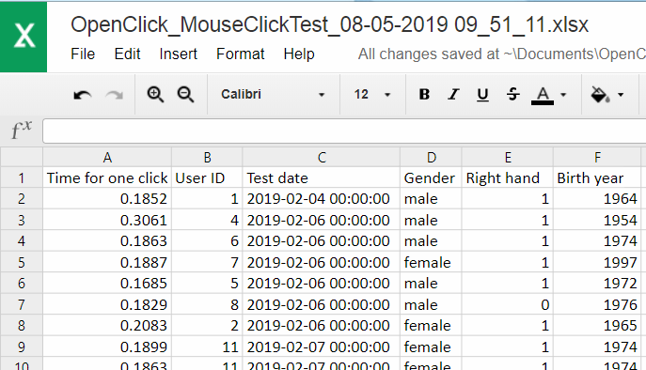
Open data example: OpenClick
Click Resources > Download data sets
Click on Mouse clicks test
Click on
“OpenClick_MouseClickTest_08-05-2019 09_51_11.csv”
You can process the data now

Slide 37
Data processing examples
Mouse clicks test
  Time for one mouse click (only left button): 0.2469
Alternate mouse button selection
 | Left button time | Right button time | Middle button time | Double click time
All | 1.029506 | 0.910285 | 0.997979 | 1.389282
Female | 1.006681 | 0.806984 | 1.023247 | 1.343797
Male | 1.046136 | 0.985546 | 0.979568 | 1.422421
All <20 years | 1.014585 | 0.752221 | 0.881470 | 1.404601

Slide 38
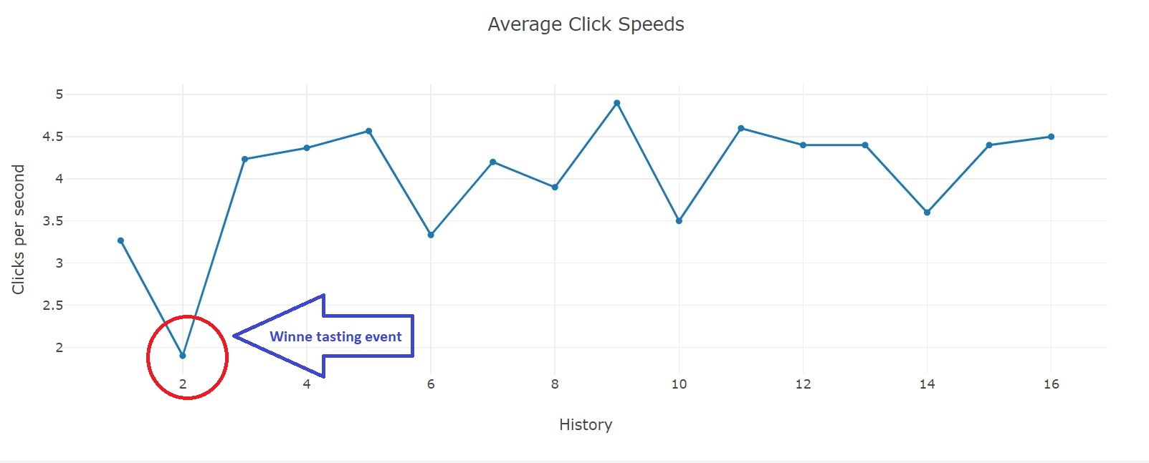
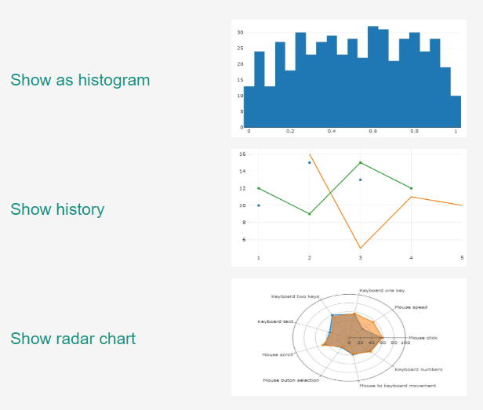
More results – Show history

Slide 39

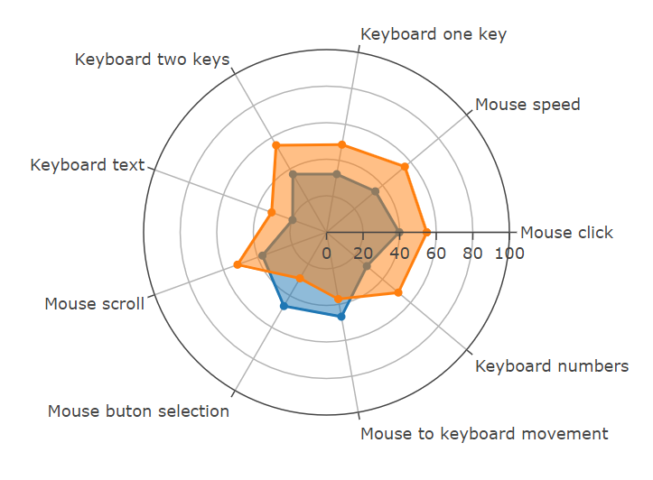
More results – Show radar chart

Slide 40
Open Materials
In addition to data sharing, the openness of research relies on sharing of materials.
Examples of materials that can be shared:
  Reagents (a substance, compound or mixture that can be added to a system in order to create a chemical or other reaction)
  Protocols (a formal or official record of scientific experimental observations in a structured format). Example repository: Protocols.io.
  Notebooks, containers, software, and hardware.
    Containers and notebooks can be shared with Rocker or Code Ocean.
    Software and hardware used in research should be shared following best practices for documentation as outlined in Open Research Software and Open Source chapter.

Slide 41
What is Open Methodology?
The term "open methodology" includes procedural, technical and technological solutions intended for use in scientific research, which are openly available to the scientific community
These solutions can be available in their final form, but are usually open to further development, which implies that each member of the scientific community can contribute to their improvement
The key feature of open methodologies is their transparency, that is, their direct applicability by the end user
At this point, probably the best illustration of open methodologies are different software solutions, such as the statistical software environment R or software solutions such as statistical packages JASP or jamovi
Example: OpenClick methodology: http://openclick.rs/index.php/en/project-openclick/methodology

Slide 42

What is Open Research Software?
Open (or open-source) research software refers to the use and development of software (for analysis, simulation, visualization, etc.) where the full source code is available
must be distributed in source and/or compiled form (with the source code available in the latter case)
must be shared under a license that allows modification, derivation, and redistribution
Photo by The Open Source Initiative is licensed under CC BY-SA

Slide 43
Pros of using open research software
Sharing software used for research (whether computational in nature, or that relies on any software-based analysis/interpretation) is a necessary, though not sufficient, condition for reproducibility (unavoidable ambiguity arises when trying to fully describe software using natural language)
Sharing software openly allows developers to receive career credit for their efforts, either through direct citation (Smith et al., 2016) or via software meta-articles
  Software meta article journal examples: Journal of Open Research Software or the Journal of Open Source Software (Smith et al., 2018)
  A list of many domain-specific journals that publish software articles by Neil Chue Hong

Slide 44
Storage and unique identification of open software
Git is a popular tool that allows version control: management and overall tracking of changes in a particular piece of software
Services such as GitHub, GitLab, Bitbucket, and others provide an interface to Git as well as remote storage services that can be used to maintain, share, and collaborate on research software
Apart from software publishing and version control, it is equally important to have a published and persistent identifier associated with it, such as a DOI
There are several ways of associating a DOI with a GitHub repository; the easiest one is to employ Zenodo (a free, open catch-all repository created by OpenAIRE and CERN)

Slide 45
Open source licensing
Publicly shared software is not actually open source unless accompanied by a suitable license, as any other creative work it falls under exclusive copyright to the creators - no one else can use, copy, distribute, or modify your work (choosealicense.com)
An appropriate license should be used for software, based on what is preferred to let others do (or prevent them from doing) with the code
If the code is to be shared with no restrictions – dedicate it to the public domain (The Unilicense)
The choosealicense.org site is a helpful resource to differentiate between licenses, although it does not feature every available or popular open-source license
Once a license is selected, the text—edited to include the author name(s) and year—is put in the software repository as a plaintext LICENSE file

Slide 46
If you choose no licence...
When you make a creative work (which includes code), the work is under exclusive copyright by default
Unless you include a license that specifies otherwise, nobody else can copy, distribute, or modify your work without being at risk of take-downs, shake-downs, or litigation
Once the work has other contributors (each a copyright holder), “nobody” starts including you!
Source: https://choosealicense.com/no-permission/

Slide 47

What is Open Access?
Image by art designer at PLoS, modified by Wikipedia users Nina, Beao, and JakobVoss - http://www.plos.org/ / CC0
Research publications (like articles and books) can be accessed online, free of charge by any user, with no technical obstacles (like mandatory registration or login to specific platforms)
Ideally, additional rights should also be provided: to copy, distribute, search, link, crawl and mine

Slide 48

Gold Open Access (Open Access publishing)
The published work is made available in Open Access
mode by the publisher immediately upon publication
The most common business model is based on one-off payments by authors (commonly called APCs – article processing charges)
The publisher charges a fee directly from the author or more often indirectly from the institution or the financier of the project

Slide 49



Open Access journals
(
)
©
?
According to the Directory of Open Access Journals (DOAJ), in April 2019 more than 13,000 journals
An open access journal must provide free access to its contents, but it also must license them to allow reusability. No legal notice must be legally understood as "all rights reserved".
The definition of an OA journal does not include any condition about the business model, but these are commonly known as journal where you have to pay to publish.
  This misconception is due to the fact that the most successful journals and the ones that got the highest impact follow this model.
  A study shows that the majority of journals registered in DOAJ do not charge any fee for publication (data available here).

Slide 50
„Predatory“ publishers
This is a proposition by American librarian Jeffrey Beall to label publishers publishing in an open-access regime, charging mainly high publishing fees but not providing a proper review process and quality control.
Jeffrey Beall recently updated his list of predatory publishers and magazines, but this site was removed under the pressure of publishers who thought they were unjustly accused. A similar list is currently available at this address.
Predatory editorial policy may be illustrated by detailed analysis of two journals from Bosnia and Herzegovina that were once removed from the Web of Science: Legitimacy of citations in predatory publishing: The case of proliferation of papers by Serbian authors in two Bosnian WoS-indexed journals by Center for Evaluation in Education and Science.

Slide 51

Green Open Access (self-archiving)
The published work or the final peer-reviewed manuscript, accepted for publication is made freely and openly accessible by the author, or a representative, in an online repository
Usually, it is not allowed to publish the final manuscript, prepared for printing by the publisher, but only pre-prints (pre-refereeing) or post-prints (final draft post-refereeing)
Some publishers request that Open Access be granted only after an embargo period (several months to several years)

Slide 52
Other Open Access modes
Hybrid Open Access. Journals charge a subscription or the cost of downloading articles, but allow authors to open access to their article by additional payment of processing fees
  Institution may pay twice: for the subscription to the entire magazine and for publishing one or more articles
Platinum Open Access. Does not charge either a subscription or a fee from the author. Expenses are covered by other means, such as volunteer work, donations, subsidies, grants, etc.

Slide 53
Journal paper versions allowed to deposit
Some journals allow the dissemination of the submitted version (preprint), and its replacement for a reviewed version (once the final paper is published)
Due to the increase of policies requiring access to research results, most of the journals allow to deposit the accepted version of the paper, a.k.a. author manuscript or postprint (the final text without final layout).
Some journals allow researchers to deposit the final published version, a.k.a. the version of record

Slide 54
Preprints
Preprints are documents that have not been peer reviewed but are considered as a complete scientific publication in a first stage.
Widely used in physical sciences and now emerging in life sciences and other fields.
Publication through institutional repositories and preprint servers.
Some of the preprints servers include open peer review services and the availability to post new versions of the paper once reviewed by peers.
Open peer review processes of preprints enabled on new publishing platforms (see Wellcome Trust or the Bill and Melinda Gates Foundation).
Even the European Commission is planning to launch a publishing platform for the Horizon 2020 funded projects.

Slide 55
Repositories and self-archiving
In April 2019 more than 4700 repositories available, according to the Registry of Open Access Repositories.
  Institutional repositories - managed by research institutions to provide a place to archive and share openly papers and other research outputs
  Subject based repositories - usually managed by research communities and most of the contents are related to a certain discipline.
  Harvesters aggregate content from different repositories. Sites to perform general searches and build other value-added services.
A good choice is EU-cofounded repository ZENODO

Slide 56
Embargo period
In relation to the moment to make the paper publicly available, many journals establish a period from its original publication: the embargo period, which can range from zero to 60 months
Some journals include or exclude embargoes depending on the versions
  For instance, the accepted version could be made publicly available after publication, but the published version must wait 12 months

Slide 57
Example: OpenClick related papers
OpenClick portal > Project OpenClick > Published Papers
Link: http://www.openclick.rs/index.php/en/project-openclick/published-papers
Two self –archived conference papers

Slide 58


How to determine self-archiving policy of a journal?
?
At any of the portals that provide general information as SHERPA/RoMEO.
Based on the information available at the corresponding website
There are still some researchers reluctant to deposit other versions than the final published version. It is important to inform them about the copyright implications when they sign a transfer document.

Slide 59
Open Access publication example (1)
Task: check Open Access options for the paper „Mišić, D., Zdravković, M., Mitković, M., Vitković, N., & Mitković, M. (2018). Real-Time Monitoring of Bone Fracture Recovery by Using Aware, Sensing, Smart, and Active Orthopedic Devices. IEEE Internet of Things Journal, 5(6), 4466-4473.“
Solution:
Google the paper. Only the abstract is available for free on publisher’s site. Login is required for download.
Use SHERPA/RoMEO to find about „IEEE Internet of Things“ journal policies:
  This is a RoMEO green journal (can archive pre-print and post-print or publisher's version/PDF). With further reading it is clear that only pre-prints and post-prints may be published, which is OK for green open access.
  A paid open access is available (IEEE Open Access Publishing Options). As subscription is needed, this is a „hybrid“ journal. Double payment by a person or institution may occur.

Slide 60
Open Access publication example (2)
General conditions for „IEEE Internet of Things“ journal are (comment on these):
  Author's pre-print on any website or pre-print server
  Author's post-print on author's personal website or employer's website or IEEE approved not-for-profit third party (8.1.9.G.2) website
  Author's pre-print must be replaced by the accepted version, if on the author's personal website, employer's websites, arXiv, IEEE-approved third-party, not-for profit server, funder repository
  Author's pre-print must removed on third-party servers
  Author's pre-print must be accompanied with set phrase (see policy) before acceptance
  Author's pre-print must be accompanied with set phrase (see policy) when accepted for publication
The content from SHERPA/RoMEO is licensed under CC BY-NC-ND

Slide 61
Open Access publication example (3)
General conditions for „IEEE Internet of Things“ journal (continued):
  If funding agency rules apply, authors may post author's post-print version on funder's designated repository or institutional repository, in compliance with their funding agency rules. They may be required to comply with embargo periods of 0 to 24 months
  Publisher copyright and source must be acknowledged with citation (see policy)
  Must link to publisher version with DOI
  Publisher's version/PDF cannot be used
  Author's post-print on scholarly collaboration networks that have signed STM Sharing Principles
  Publisher retains copyright
The content from SHERPA/RoMEO is licensed under CC BY-NC-ND

Slide 62
Open Access publication example (4)
If journal policy is explored further (Author Posting of IEEE Copyrighted Papers Online - Policy: Posting Your Article) it may be found that the accepted article may be posted only on author’s personal website, author’s employer’s website, arXiv.org or funder’s repository (with embargo period of 24 months that may be shortened if the funder requests so).
Authors should ask the publisher for article version that includes the Digital Object Identifier, IEEE's copyright notice, and a notice showing the article has been accepted for publication.
Preprint could have been published on Scholarly Collaboration Networks (SCNs) before acceptance. It could not have been published on ResearchGate, as it is not the signatory to the International Association of Scientific, Technical and Medical Publishers’ “Sharing Principles”.
Preprint must be accompanied with set phrase (see Policy: Posting Your Article). Preprints have to be removed after the accepted paper is published.

Slide 63
Open Access Exercise
For a given paper from the list on next page, do the following:
  Google the paper and find its original journal page and DOI. Use Google Scholar if needed to filter the search results.
  Check if the journal is listed in DOAJ – is it an Open Access journal?
  Find Open Access policy for the journal using SHERPA/RoMEO. Answer the following questions (using main course presentation as an example):
    Which Romeo journal is it (green/blue/yellow/white)? What does it mean (see “Archiving policy“ on the bottom of the page)?
    Which paper versions may be published (pre-prints, post-prints, publisher’s version/PDF)?
    What are Open Access related general conditions for the journal?
    If there is OA publishing cost (APC), how much is it? If the journal is not purely Open Access, is there a paid Open Access option? If yes, use given link to find the fee on publisher’s site. Which kind of Open Access journal is this?
    Using the links in “Copyright” section find further information related to self-archiving, if applicable:
      What is the embargo period for the paper (journal)?
      Is the article free to access after the embargo period (from publisher’s site)?
      How to attach a user license to a post-print?
  Use the site How can I share It? and paper DOI to find out where and how the paper from the journal can be shared.
  I f the journal is no fully Open Access, find the journal (or publisher) page defining paper publishing options. Where can the post prints be shared immediately?

Slide 64
Papers for Open Access exercise
Korunovic, N., Marinkovic, D., Trajanovic, M., Zehn, M., Mitkovic, M., & Affatato, S. (2019). In Silico Optimization of Femoral Fixator Position and Configuration by Parametric CAD Model. Materials, 12(14), 2326.
Korunović, N., Fragassa, C., Marinković, D., Vitković, N., & Trajanović, M. (2019). Performance evaluation of cord material models applied to structural analysis of tires. Composite Structures, 224, 111006.

Slide 65




Open peer review
Open peer review (OPR) aims to bring greater transparency and participation to formal and informal peer review processes
There exists a number of overlapping ways in which peer review models may be adapted to the aims of Open Science
Most important features:
  “Open identities”, where both authors and reviewers are aware of each other’s identities (i.e., non-blinded)
  “Open reports”, where review reports are published alongside the relevant article
  “Open participation”, where members of the wider community are able to contribute to the review process

Slide 66
Alternative metrics
Alternative Metrics” or altmetrics – a proposal for balanced assessment of research efforts
Citation counting is complemented by other online measures of research impact, including bookmarks, links, blog posts, tweets, likes, shares, press coverage...
A particular advantage to early-career researchers, whose research-impact may not yet be reflected in significant numbers of citations
Helps in identification of influential research and potential connections between researchers

Slide 67
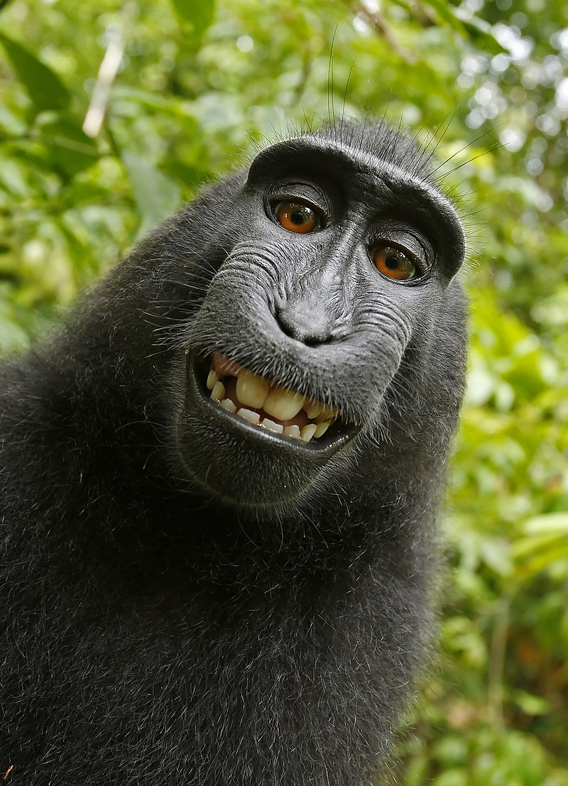
Copyright ☺
Source: https://en.wikipedia.org/wiki/Copyright, licensed under WP:CC BY-SA
Source: Wikipedia
Copyright is a form of intellectual property that grants the creator of an original creative work an exclusive legal right to determine whether and under what conditions this original work may be copied and used by others, usually for a limited term of years
As animal-made art, this monkey selfie is ineligible for copyright in the United States

Slide 68
What is open licensing?
A license is a legal document that grants specific rights to user to reuse and redistribute a material under some conditions
Licenses can be applied to any material where some exploitation or usage rights exist (e.g., sound, text, image, multimedia, software)
Free content licenses are licenses that grant permission to access, re-use, and redistribute material with few or no restrictions

Slide 69
Open license and copyright
Any creative work is automatically copyrighted, i.e. under copyright terms “all rights reserved” - copyright holder reserves, or holds for its own use, all the rights provided by copyright law
By specifying an open license copyright terms are changed to “some rights reserved”, i.e. copyright holder can choose how the work is shared
Applying an open license to a scientific work (an article, dataset or other type of research output) is a way for the copyright holder to express the conditions under which the work can be accessed, re-used and modified
Since copyright laws are not internationally harmonized one must refer to
the applicable laws in current context

Slide 70

Creative Commons (CC) licenses
The most used licenses for scientific content are Creative Commons licenses
Depending on CC license type:
  one is always obliged to attribute the authors (give credit, indicate changes)
  material may be free or not free to adapt (remix, transform, and build upon the material)
  Commercial use may be allowed or not allowed
There are also public domain related CC licenses - „all rights granted“

Slide 71


CC licenses – License Conditions (1)
Attribution (by)
All CC licenses require that others who use your work in any way must give you credit the way you request, but not in a way that suggests you endorse them or their use. If they want to use your work without giving you credit or for endorsement purposes, they must get your permission first.
You let others copy, distribute, display, perform, and modify your work, as long as they distribute any modified work on the same terms. If they want to distribute modified works under other terms, they must get your permission first.
ShareAlike (sa)
Source: Creative Commons licenses, licensed under CC BY 4.0.

Slide 72


CC licenses – License Conditions (2)
NonCommercial (nc)
You let others copy, distribute, display, perform, and (unless you have chosen NoDerivatives) modify and use your work for any purpose other than commercially unless they get your permission first.
You let others copy, distribute, display and perform only original copies of your work. If they want to modify your work, they must get your permission first.
NoDerivatives (nd)
This movie explains the effect of various license conditions on sharing and reuse of CC licensed work.
Source: Creative Commons licenses, licensed under CC BY 4.0.

Slide 73
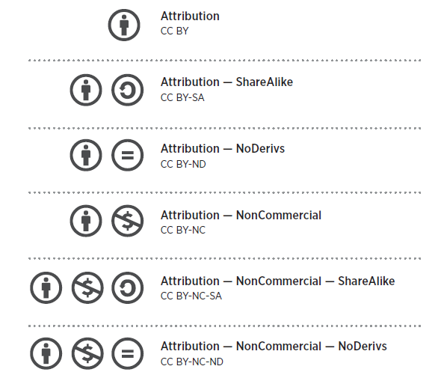
Types of CC licenses
Attribution (CC BY)
Attribution ShareAlike (CC BY-SA)
Attribution-NoDerivs (CC BY-ND)
Attribution-NonCommercial (CC BY-NC)
Attribution-NonCommercial-ShareAlike (CC BY-NC-SA)
Attribution-NonCommercial-NoDerivs (CC BY-NC-ND)
Source: Creative Commons licenses, licensed under CC BY 4.0.

Slide 74
CC licenses used for scientific work
CC BY license (only attribution) - a good option for scientific works like articles, books, working papers, and reports
  Lets others distribute, remix, tweak, and build upon the work, even commercially, as long as they credit the author for the original creation
  Recommended for maximum dissemination and use of licensed materials
CC0 - recommended for datasets and databases
  Built for jurisdictions where a full public domain dedication is not possible (e.g. in many continental Europe countries).
  Creative Commons CC0 Public Domain Dedication waives copyright interest in a work you've created and dedicates it to the world-wide public domain
  Used to opt out of copyright entirely and ensure the work has the widest reach

Slide 75
An example of CC license in Open Science (1)
Task: based on your scientific work, you (John Smith) created a web site „Internet of things and electric cars“. You want to enable intensive sharing of your ideas without copyright issues and to be credited by others for your work.
Solution
  Go to Creative Commons site to choose a license.
  Below “Allow adaptations of your work to be shared?” choose Yes.
  Below “Allow commercial uses of your work?” choose Yes.
  You should have selected Attribution 4.0 International license. Click on license link to see the simple description, named “the Commons Deed (also known as the “human readable” version of the license)”. There are two more layers that describe the same license: Legal Code, written in the formal language of law, and Machine Readable, a summary that software systems can understand (see details here).

Slide 76
An example of CC license in Open Science (2)
Solution (continued)
  Examine license elements (that explain what others should be aware of or what should they do if they share or use your work):
    You are free to:
      Share — copy and redistribute the material in any medium or format.
      Adapt — remix, transform, and build upon the material for any purpose, even commercially.
    Under the following terms:
      Attribution — You must give appropriate credit, provide a link to the license, and indicate if changes were made. You may do so in any reasonable manner, but not in any way that suggests the licensor endorses you or your use.
      No additional restrictions — You may not apply legal terms or technological measures that legally restrict others from doing anything the license permits.
  On the bottom of page click on use the license.

Slide 77
An example of CC license in Open Science (3)
Solution (continued)
  Choose which style of button you'd like on your webpage (choose left icon)
  If you are satisfied with preview of the license, copy the code from grey window to your web site, to be shown in an appropriate place (e.g. on the bottom of each page).
  The code to copy should look like:
    <a rel="license" href="http://creativecommons.org/licenses/by/4.0/"><img alt="Creative Commons License" style="border-width:0" src="https://i.creativecommons.org/l/by/4.0/88x31.png" /></a><br />This work is licensed under a <a rel="license" href="http://creativecommons.org/licenses/by/4.0/">Creative Commons Attribution 4.0 International License</a>.
  The license should appear like:
  This work is licensed under a Creative Commons Attribution 4.0 International License.

Slide 78
Attributing CC licensed work
Most CC licenses require that the authors of the shared work are attributed
Some authors note how the attribution should be made, but most of the times the one that is attributing should know to create the attribution
The wiki-how article How to Attribute a Creative Commons Licensed Work gives step-by-step instructions on how to:
  Find information for attribution
  Create the attribution
  Provide data to help others attribute someone’s own work

Slide 79
An example – attributing CC licensed work (1)
Task: You are a scientists who likes the work of John Smith from the previous example, and want to use it on you web site. On one page, you will feature the exact copy of John’s work. On the other, you will remix his material, by extracting some chapters and using them as bulleted points. You want to create and use a proper attribution for both pages.
Solution:
Find licensing information on John Smith’s site. You should find the text “This work is licensed under a Creative Commons Attribution 4.0 International License.”
Click on license link and check license elements. You should see that you are free to share and adapt, if you attribute the author and indicate if changes were made.
Go to wikiHOW page How to Attribute a Creative Commons Licensed Work.
Click on “Sample Attributions” and on General Creative Commons Attribution, where you can find attribution example for the case where no changes were made.

Slide 80
An example – attributing CC licensed work (2)
Solution (continued):
  Read the text. On the bottom of the page, find the attribution template: “[Title, including link to original source]” by [author, including profile page link if possible] is licensed under [license, linked to license deed if possible].
  Use the template to create attribution. If you need further explanations, read the content of How to Attribute a Creative Commons Licensed Work.
  The attribution should look like: “Internet of things and electric cars by John Smith is licensed under CC BY 4.0”. In previous sentence, the title of the work should be linked to John’s web page about electric cars and his name should be linked to his profile web page.
  Return to wikiHOW page How to Attribute a Creative Commons Licensed Work.

Slide 81
An example – attributing CC licensed work (3)
Solution (continued):
  Click on “Sample Attributions” and on Creative Commons Attribution for Modified Material, where you can find attribution example (if changes were made).
  Read the text. On the bottom of the text, find the attribution sample, which is similar to previous one but contains a “/” in the end followed by indication of what was changed.
  Use the template to create attribution. If you need further explanations, read the content of How to Attribute a Creative Commons Licensed Work.
  The attribution should look like: “Internet of things and electric cars by John Smith is licensed under CC BY 4.0 / Original chapter separated into bulleted points”

Slide 82
Software licensing
Creative Commons licenses should not be used for licensing software because they were not designed for that purpose, as the organization states
Software developers should use appropriate licenses like those collected by the Open Source Initiative or Free Software Foundation (https://choosealicense.com)

Slide 83
Example: OpenClick License
License text :
http://www.apache.org/licenses/LICENSE-2.0
License information: http://www.openclick.rs/index.php/en/resources/licensing
Attributation only and patent rights protected

Slide 84


File formats and open science
A file format is a standard way that information is encoded for storage in a computer file
Not all formats have freely available specification documents, partly because some developers view their specification documents as trade secrets
Within the context of Open Science, files should not be compressed or encrypted and should avoid proprietary or patent-encumbered formats in favor of open formats. This ensures the access and re-usability of the content

Slide 85




Examples for open file formats
Text: TXT, ODT, PDF/A, XML
Tabular data: CSV, TSV
Image: TIFF, PNG, JPG 2000, SVG, WebP
Audio: WAV, FLAC, OPUS
Video: MPEG2, Theora, VP8, VP9, AV1, Motion JPG 2000 (MJ2),
Binary hierarchical data: HDF5

Slide 86



Collaborative platforms
Collaborative platforms are usually online services that provide a virtual environment to which multiple people (geographically-dispersed) can concurrently connect and work on the same task
Virtual research environments (VREs) facilitate sharing and collaboration tools (e.g. forums), collaborative document hosting and discipline-specific tools
Single specific tools enable researchers to work together in real time on specific aspects of research (such as writing or analysis). Include social networks.

Slide 87







What are Open educational resources?
"Teaching, learning and research materials in any medium – digital or otherwise – that reside in the public domain or have been released under an open license that permits no-cost access, use, adaptation and redistribution by others with no or limited restrictions" (William and Flora Hewlett Foundation definition)
Open educational resources include:
  full courses, course materials, modules,
  textbooks, streaming videos, images,
  tests, software,
  any other tools, materials, or techniques
  used to support access to knowledge.

Slide 88
Open educational resources and Open Science
Open educational resources are often built upon research findings
An Open Science practitioner will probably want his educational resources to maintain the level of openness as his research
Other teachers can use the open material to elaborate new resources or adapt existing ones
The creation of educational resources can be seen as a cycle similar to the research cycle: find, compose, adapt, use, and share

Slide 89
OER platforms and their intended use
OpenCourseWare (OCW) is one of the first open educational resource platforms and key initiators of the OER movement.
Open Education Consortium, initiated at MIT in 2002 provides materials from all over the world as courses under free licenses.
Other examples of OER platforms:
  Creative Commons Search for image, audio, and video files
  OERCommons for educational resources

Slide 90

What are Open Science Policies?
Strategies and actions aimed at promoting Open Science principles and at acknowledging Open Science practices
Usually established by: research institutions, research funders, governments or publishers
Initial policies were based on the idea that results achieved from publicly funded research should be available to the public without any restriction
Now the scope of the policies has grown:
  National policies foster Open Science practices at any point of the research level
  There are specific provisions in new and existing laws, regulations or directives

Slide 91
Stakeholders and relevant OS politics topics
Researchers
  How Open Science policies affect them
Policy makers
  Designing and implement a policy to foster Open Science
Funders or policy makers within an institution
  How to design, develop, implement and monitor a policy

Slide 92

EU policy and Open Science
EU has recognized that linking science and society leads to advance in all areas.
The importance of open access to data and research results has been present in Europe for a long time but is particularly prominent in the calls and recommendations related to H2020 projects. Within H2020, EC requires that all participants have to ensure Open Access to the publications generated during the research, while in the domain of open data it is recommended to enable Open Access whenever possible.
The principle of ‘Open Science' will become the modus operandi of Horizon Europe, requiring open access to publications and data.
In order for current recommendations to become reality in Europe, EC has implemented various projects and initiatives in last ten years.
Photo is licensed under CC BY-SA

Slide 93
OpenAIRE project
OpenAIRE (Open Access Infrastructure for Research in Europe) is one of the pioneering projects, which started in 2006, under the name “Driver”. Goals:
  creating a network of digital repositories, for storing digital data
  to support the implementation of open access in Europe
OpenAIREPlus expanded the network of repositories, including specific scientific fields related ones
OpenAIRE2020:
  possibilities of finding and using the results of projects realized under the H2020 program
  creation of services that enable the exchange of scientific data, literature and methods.
OpenAIREAdvance continues to support Open Access and Open Data in Europe

Slide 94
Other Open Science related EU projects
FOSTER, 2014, accelerating acceptance of an open approach in the context of the ERA. Showed that OA principles can be integrated into the research process
FosterPlus - to help accept the principles of open science in Europe
The most recent and probably the most comprehensive initiative: European Open Science Cloud
  Launched in 2015, opened 23.11.2018.
  By 2020, it should lead to the creation of a virtual environment for all researchers in which they can store, manage, analyze and reuse their data, related to research, innovation and education

Slide 95
European Open Science Cloud (EOSC)
European Cloud Initiative, a part of the package of measures for Digitising European industry, provides European science, industry and public authorities with:
  a world-class data infrastructure to store and manage data (European Open Science Cloud);
  high-speed connectivity to transport data (European Data Infrastructure); and
  ever more powerful High Performance Computers to process data (HPC)
A European Open Science Cloud (EOSC) offers Europe's researchers and science and technology professionals a virtual environment to store, share and re-use the large volumes of information generated by the big data revolution
This is underpinned by the European Data Infrastructure (EDI), deploying the high-bandwidth networks and the supercomputing capacity necessary to effectively access and process large datasets stored in the Cloud
Open Science in Europe by OpenAIRE is licensed under CC BY 4.0 / Selected sentences, shortened

Slide 96
cOALition S
On 4 September 2018, a group of national research funding organizations, with the support of EC and the ERC, announced the launch of cOAlition S
It is an initiative to make full and immediate Open Access to research publications a reality.
It is built around Plan S, which consists of one target and 10 principles.
“With effect from 2021, all scholarly publications on the results from research funded by public or private grants provided by national, regional and international research councils and funding bodies, must be published in Open Access Journals, on Open Access Platforms, or made immediately available through Open Access Repositories without embargo”

Slide 97

What is Open Advocacy?
Advocacy in all its forms seeks to ensure that people, particularly those who are most vulnerable in society, are able to:
  Have their voice heard on issues important to them
  Defend and safeguard their rights
  Have their views and wishes genuinely considered when decisions are being made about their lives
Includes defending, influencing, changing, decision-making, persuading, lobbying, attracting attention
Open Advocacy focuses on the movement to promote Open Science at various levels of stakeholders, highlighting and stressing the societal, professional and personal advantages that it entails
Photo by Manco Capac is licensed under the Creative Commons Attribution-Share Alike 4.0 International, 3.0 Unported, 2.5 Generic, 2.0 Generic and 1.0 Generic license.

Slide 98



Advocacy and EURAXESS trainings
This Photo by Unknown Author is licensed under CC BY-SA-NC
Trainings (workshops, seminars, presentations) can be used as advocacy tools
Training here is considered as a tool for effecting specific changes, and for building an Open Science advocate community

Slide 99
How to organize OpenScience training
Use this and the extended presentation available on EURAXESS Extranet and OpenClick portal and create your own training materials
  The materials should be adapted to the audience, be interactive and include specific examples and exercises
Book the trainer over EURAXESS Extranet
  If the contents of the training is similar to this one
  The training should be at least 1 day long, if held to researchers and/or institutional staff, to contain all the necessary information

Slide 100
Training contents on OS policy
Review all the policies that affect your training audience:
  All the institutional policies; copyright, IPR, open access, research data...
  Any national policy or law that can affect researchers performing OS
    laws with open access provisions or decrees affecting PhD dissertations,
    call for projects,
    national open access policies in Europe available at OpenAIRE.
  Any international policy, mainly from international funders
    At the EU level - policies regarding the dissemination of research outputs in H2020 research Framework, other policies affecting other parts of the research cycle
    Some publishers have introduced new policies, especially regarding the publication of research data when submitting a paper

Slide 101
Training for Open Science policy designers
Define the main purposes of having such a policy
Establish the goals or changes they are pursuing
Find key performance indicators to measure if the policy has achieved its goals
Review and update the policy if the goals are not achieved

Slide 102
Possible exercises – Open advocacy
Write a letter for a newsletter or forum for your scientific society about Open Access
Outline concrete solutions and benefits Open Science can deliver for current headaches university administrators may struggle with
Following „Steps to good advocacy“ create the plan for:
  Advocating open science to universities
  Advocating open science to scientists

Slide 103
Trainings for researchers
Have a researcher as one of the trainers
An overview of Open Science principles
Why should a researcher practice open science (found in this presentation)
Reproducibility, replicability
Open data – important, most of the topics listed in this presentation. Exercises depend on the group, should be prepared with researchers. OpenClick may be used as an example.
Open Access, licensing, license attribution - (important, exercises are given in the presentation, own exercises as needed)
Other topics depending on audience, the most common ones are given in next slides

Slide 104
OS platforms - possible exercises for researchers
Using Mendeley
  Create Mendeley account.
  Try searching for papers and datasets.
  Add literature to Mendeley library.
  Try inserting citations into a Word document.
  Create a group with your colleague and share a research library.
Using OSF (details in Extranet document)
  Examine an existing project on OSF platform (search using keywords of your interest)
  Create a test project on OSF platform

Slide 105
Reviewing and metrics – a possible exercise for researchers
Trainees work in groups of three. Each individually writes a review of a short academic text.
Review a paper on a pre-print server.
  List of academic journals by preprint policy.
Use a free bibliometrics or altmetrics service (e.g. Altmetric bookmarklet, Dimensions.ai, Impactstory,) to look up metrics for a paper, then write a short explanation of how exactly various metrics reported by each service are calculated.
  Use this link to access Impactstory directly.
  It’s harder than you’d assume; it is challenging to find proper metrics documentation for even the seemingly most transparent services.

Slide 106
An example use of Open Educational Resources and CC licenses
Using OpenCourseWare (OCW) site, find a course by topic of interest. Examine free course material. Find which license type is used (CC BY NC SA) and describe how you could create your own course materials based on these and which license should you use
Using Open Education Consortium site > Resources > Find OER > Open Courseware, find OpenMichigan open courseware. Select a course by topic of interest. Examine free course material. Find which license type is used (CC BY, except otherwise noted) and describe how you could create your own course materials based on these, and which license should you use

Slide 107
Training for researchers – OS policy
Identify the main features of each policy mainly:
  to whom it is addressed,
  what are the requirements,
  how the policies overlap with each other.
How researchers can satisfy the different policies:
  where are the services and tools that the institution can provide,
  where they can find alternatives
    E.g., an institution might not provide an infrastructure for depositing and publishing research data; but it can point out external solutions that fulfil policy requirements.

Slide 108
Literature
The Open Science Training Handbook: https://open-science-training-handbook.gitbook.io/book/
Open science – introduction, OSC LMU Open science center: https://mfr.osf.io/render?url=https://osf.io/z7954/?action=download%26mode=render
Vicente-Sáez, R., & Martínez-Fuentes, C. (2018). Open Science now: A systematic literature review for an integrated definition. Journal of business research, 88, 428-436.
Fecher, B., & Friesike, S. (2014). Open science: one term, five schools of thought. In Opening science (pp. 17-47). Springer, Cham.
Open Definition: http://opendefinition.org/
Smith, Arfon M., Daniel S. Katz, Kyle E. Niemeyer, and FORCE11 Software Citation Working Group. ‘Software Citation Principles’. PeerJ Computer Science 2 (19 September 2016): e86. https://doi.org/10/bw3g.
Piwowar, H., Priem, J., Larivière, V., Alperin, J. P., Matthias, L., Norlander, B., ... & Haustein, S. (2018). The state of OA: a large-scale analysis of the prevalence and impact of Open Access articles. PeerJ, 6, e4375.
Candela, L., Castelli, D., & Pagano, P. (2013). Virtual research environments: an overview and a research agenda. Data Science Journal, GRDI-013.
Other used literature is referenced throughout the text.

Slide 109

Thank you for your attention!
This Photo by Unknown Author is licensed under CC BY-SA

